Slide 1

HRMS Final Project
The Presentation Oracle System EBS

Slide 2

the problem Of traditional manual methods
The current HR system at the Egyptian Electricity Holding Company is outdated, with limited integration between different HR functions. This results in inefficient processes, inaccurate data, and difficulties in generating comprehensive reports. The current system also lacks advanced features such as automated workflow and real-time data analysis, leading to delays in decision making and increased operational costs.
Current Challenges: The current HR system at the Egyptian Gas Company is fragmented, leading to inefficiency and data inconsistency.
Manual processes are prevalent, leading to errors and delays in HR functions such as payroll and attendance tracking.

Slide 3

Automating The Human Resources Work System
Enhancing the HR management system of the Egyptian Electricity Holding Company by implementing an Oracle-based solution. This project aims to streamline HR processes, improve data accuracy, and provide better insights for decision making.

Slide 4
Our project is based on automating the human resources work system in large companies through:
Our project is based on automating the human resources work system in large companies through:
1- Converting human resources work from traditional manual methods to a digital method (digital transformation)
2- Using Oracle to record all employee files and data to facilitate their storage and access, thus we have a unified and automated human resources system that reduces manual operations and errors.
3- Improving employee participation and satisfaction through self-service capabilities by adding leave balances for each employee and facilitating the submission of leave and determining the type and duration of leave
4- Automating the recruitment and appointment system by identifying the functional needs of each department and administration and knowing the job description for each job and advertising jobs and their cost and recording the results of personal and technical interviews and tests
5- Simplifying payroll and compliance processes, which reduces time and effort by recording salaries and their elements and calculating each element with mathematical equations and verifying the accuracy of the data entered in each step and then transferring salaries to the employees' salary accounts at the bank

Slide 5

Oracle EBS
In this project, we will implement an Oracle system for the Egyptian Electricity Holding Company

Slide 6
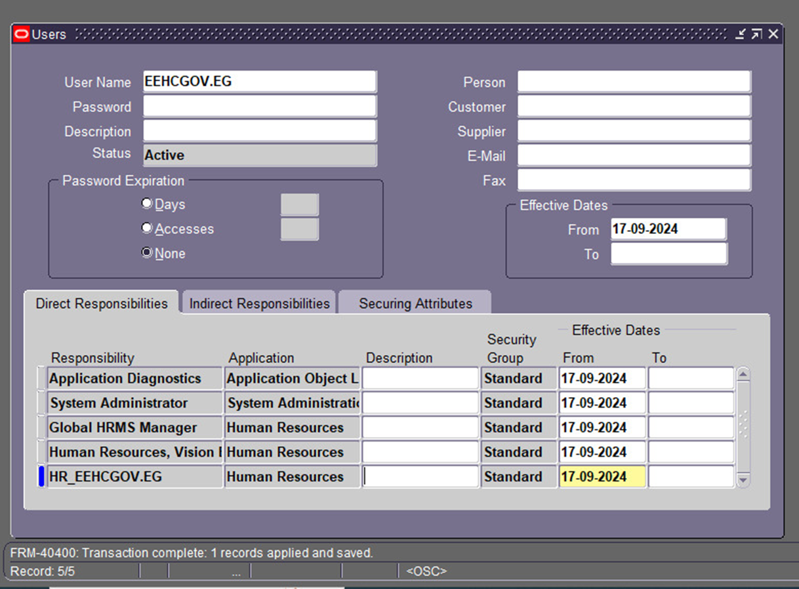
Process of adding the user in Oracle EBS?
Log in: as Administrator
Navigate to: Security > User > Define.
Create: a New User
Enter:
User Name
Password
Email
Fill in User Details:
Add: Full Name and any other relevant info.
Assign: Global HRMS Manager Responsibility
Responsibilities section, click Add.
Choose: Global HRMS Manager Responsibility.
Save Changes:
Click: Save to finish.
Test the User

Slide 7
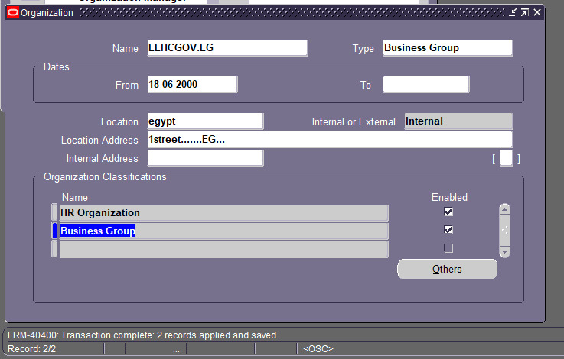
Organizations Definition
Navigate to the Setup:
Go to System Administrator responsibility.
Navigate to Organization > Organization.
Enter Organization Information:
Click on Define Organizations.
Fill in the Organization Name, Organization Type (e.g., Operating Unit, Inventory Organization), and other necessary details.

Slide 8
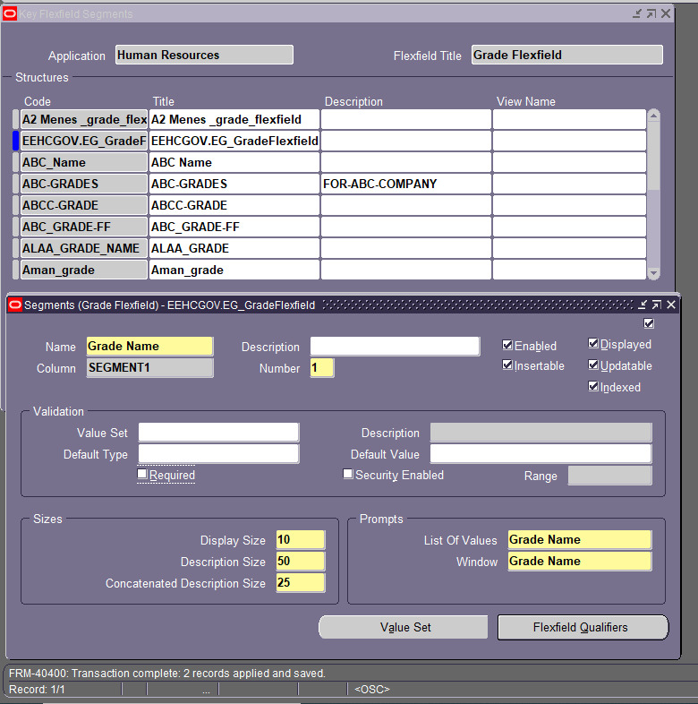
Add Grade Flexfield structure
Log In: Sign in to Oracle EBS as a System Administrator.
Go to Flexfields: Navigate to Flexfields > Key > Segments.
Find Grade Flexfield: Look for the Grade Flexfield.
Add New Segment:
Click Create.
Fill in:
Segment Name: Unique name.
Description: What it is.
Column Name: Database column name.
Assign Value Set: Create or choose a Value Set and link it to your segment.
Set Properties:
Choose Data Type
Set Length (max characters).
Decide if it’s Mandatory or Enabled.
Compile: Click Compile to save changes.
Test: Check the HR forms to see if it works.

Slide 9
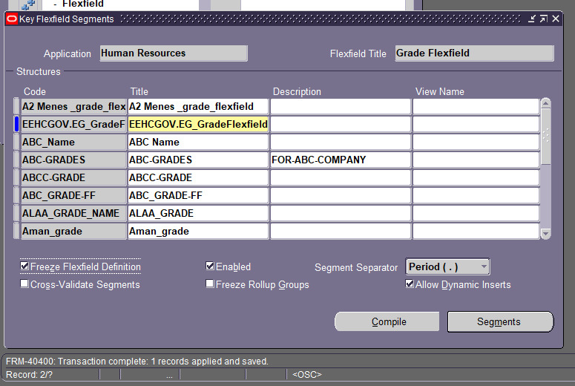
Grade Flexfield

Slide 10
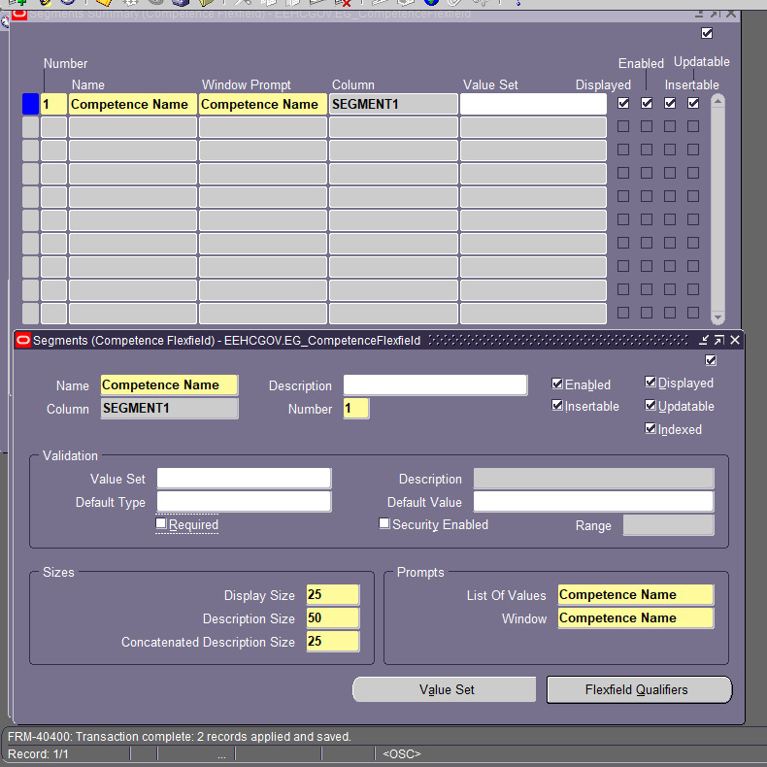
Competence Flexfield Structure
Quick Steps to Add a Competency Flexfield
Go to Setup:
Open your Oracle application and find Flexfields.
Create/Edit Flexfield:
Start a new flexfield or edit an existing one.
Add Segments:
Create segments to capture competency info (like name and type).
Set Contexts:
Define when these segments should show up.
Save and Test:
Save your work and check it in the application.

Slide 11
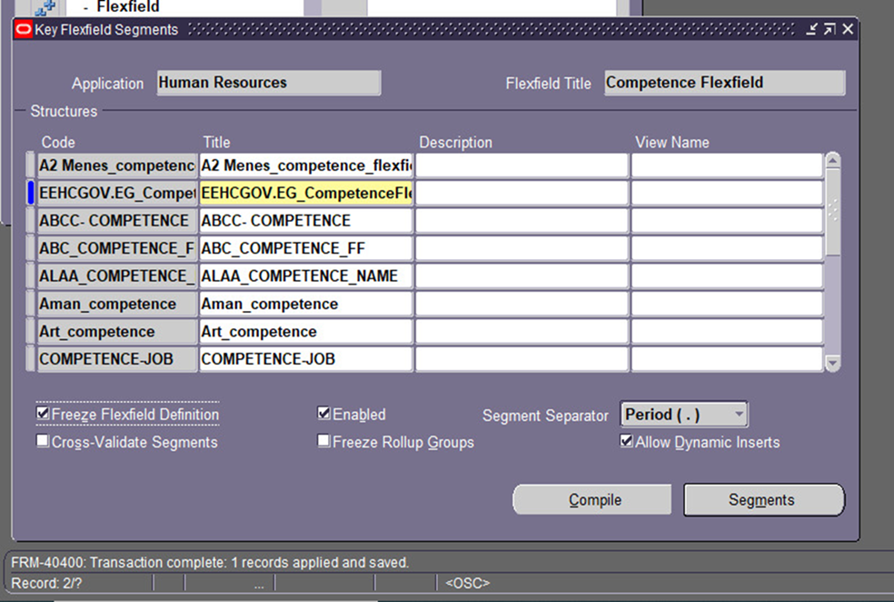
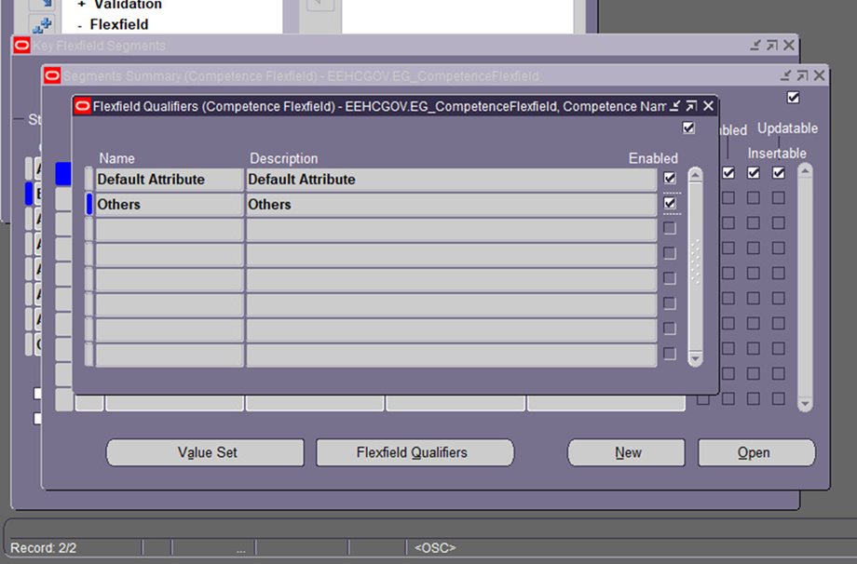
Competence

Slide 12
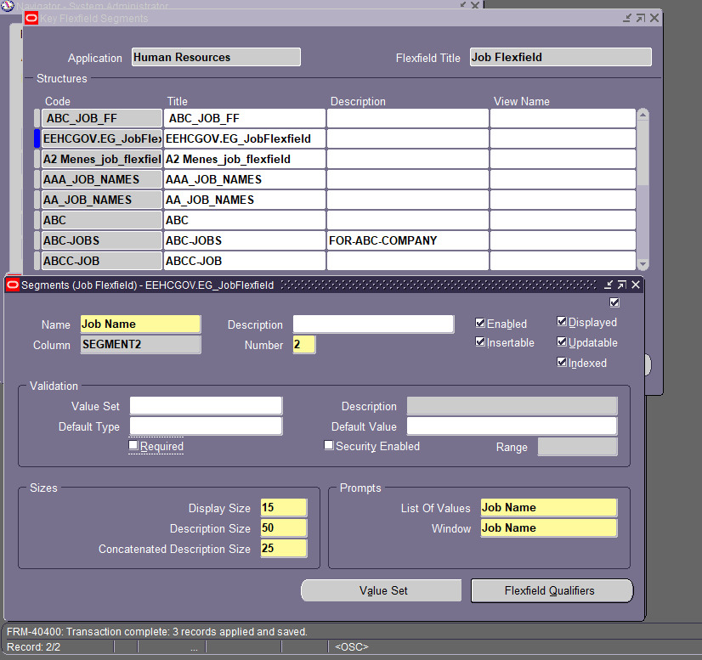
Job Flexfield Structure
Open Flexfield: Go to System Administrator > Application > Flexfield.
Choose Job Flexfield: Select Job Flexfield.
Add Segments: Click Segments and then Add Segment. Fill in the necessary details.
Save Changes: Click Save.
Compile: Run Compile Flexfields to apply changes.
Test It Out: Check if it shows up when you create or update a job.
Document: Write down what you did and train users if needed.

Slide 13
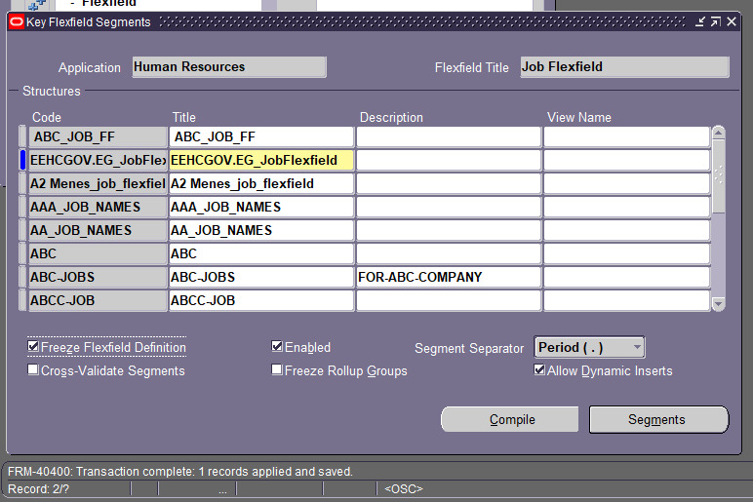
Job

Slide 14
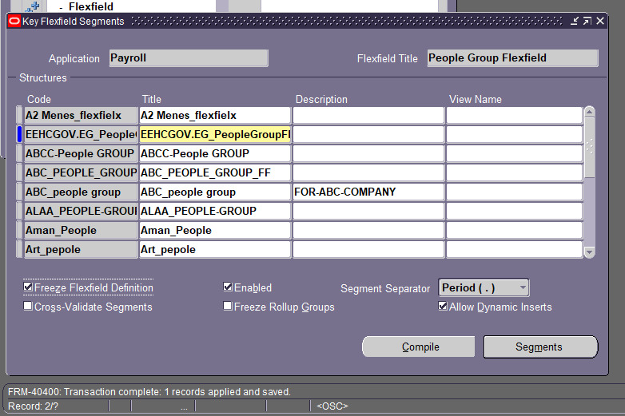
People Group Flexfield
Log In.
Go to: System Administrator > Flexfield > Key (or Descriptive).
Select People Group Flexfield.
Click on Segments.
Click New to Add Segment:
Enter Name and other details.
Save Changes.
Compile Flexfields.
Test It Out.

Slide 15
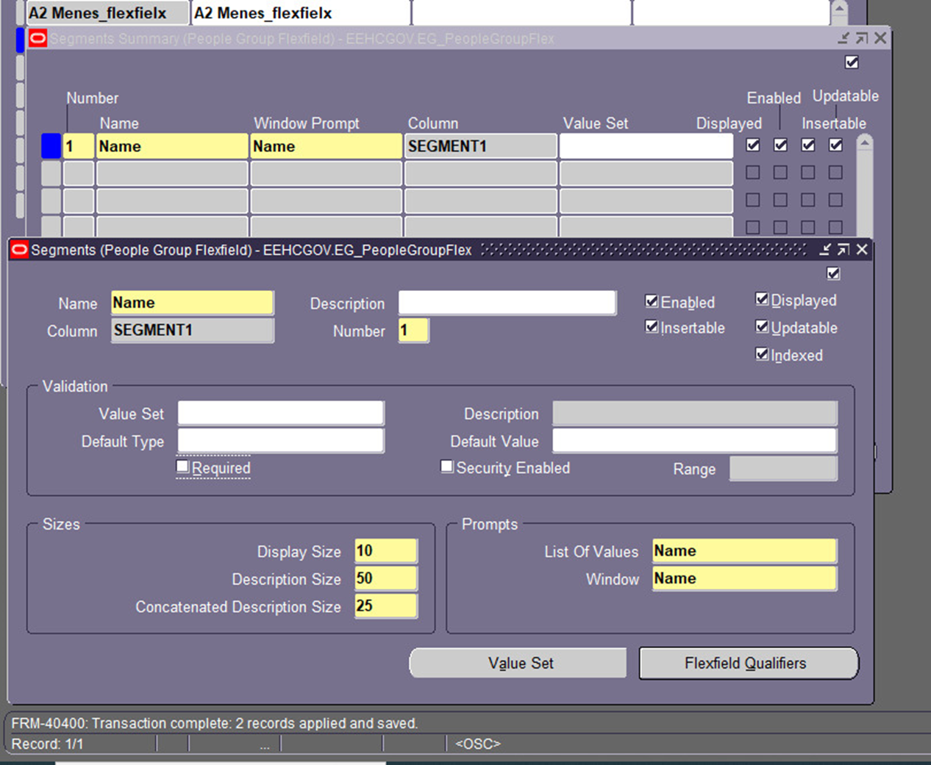
People Group Flexfield

Slide 16
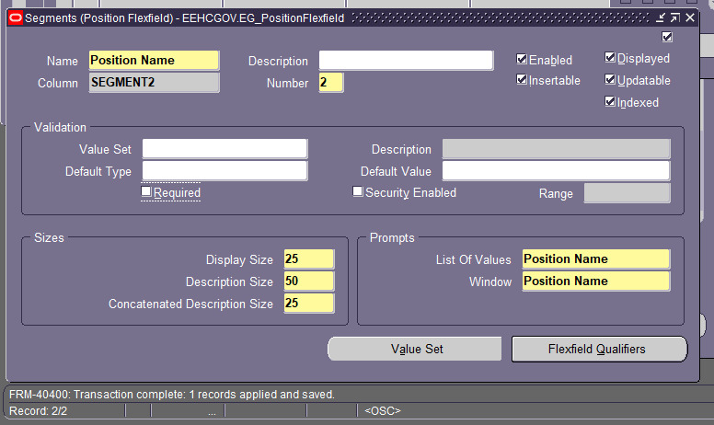
Position Flexfield
Go to: System Administrator > Flexfield > Key (or Descriptive).
Select Position Flexfield.
Click on Segments.
Click New to Add Segment:
Enter Name and details.
Save Changes.
Compile Flexfields.
Check a Position to Test.

Slide 17
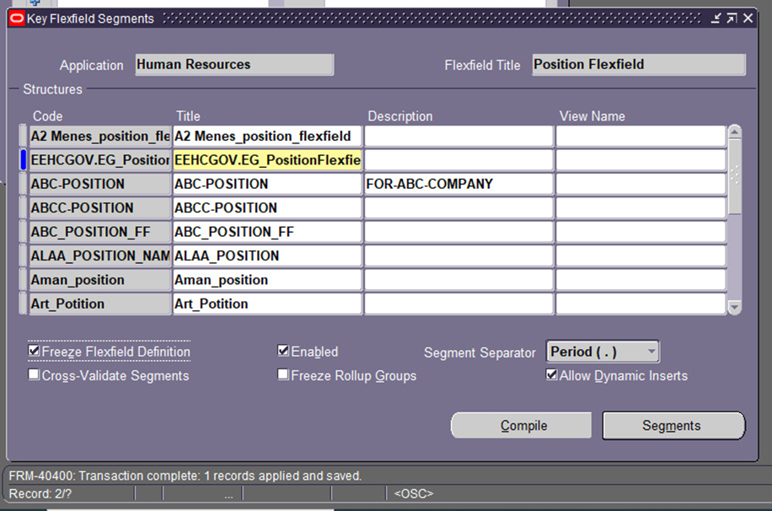
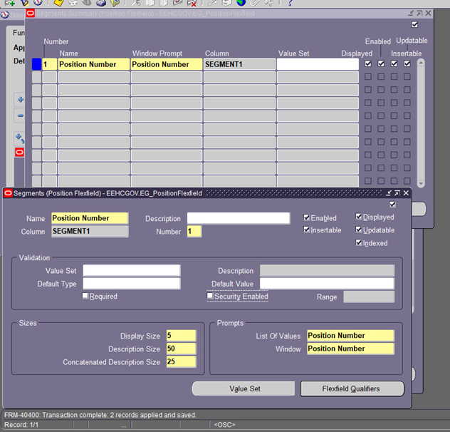
Position Flexfield

Slide 18
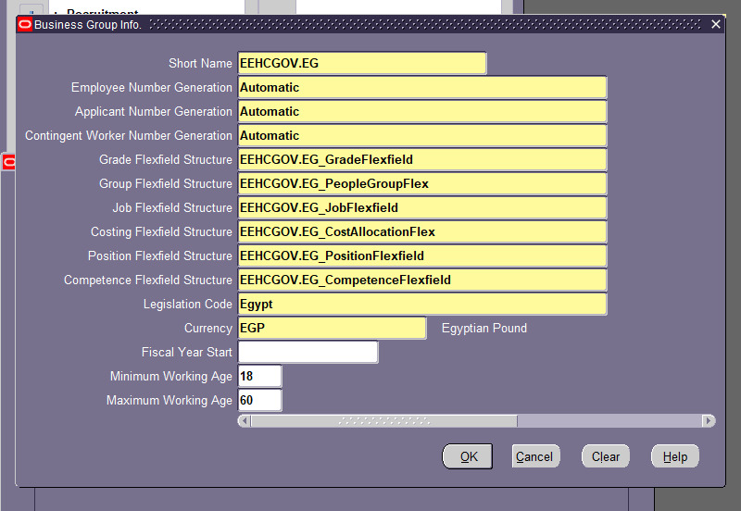
Business Group Info
Go to: HRMS Manager > Workforce Structures > Business Group.
Select a Business Group: Click on the one you want to view.
View Details: Check the information displayed.

Slide 19
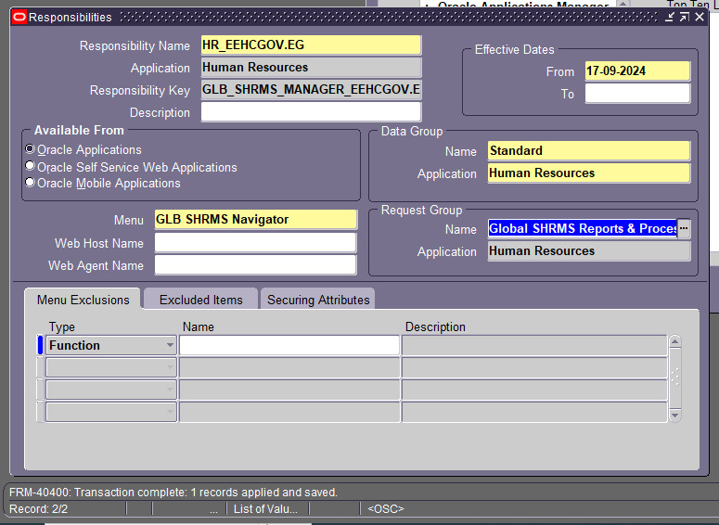
Responsibilities
Go to Responsibilities: Navigate to Security > Responsibility > Define.
Create or Edit:
Click Create for a new one or find an existing one.
Fill in Name and select the business group.
Save your changes.
Assign to User: Go to Security > User > Define and add it to the user.
Check: Have the user log in to confirm.

Slide 20

Human Resources Employees at EEHC

Slide 21
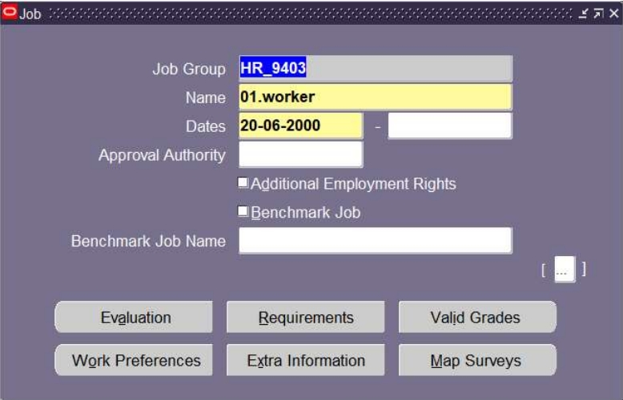
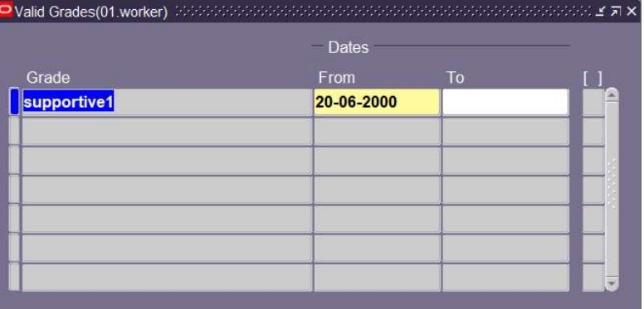
Human Resources

Slide 22
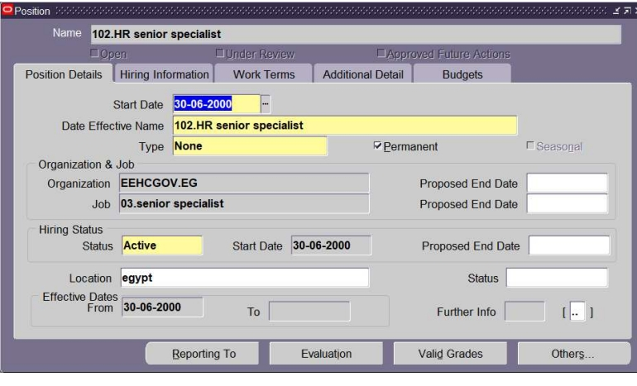
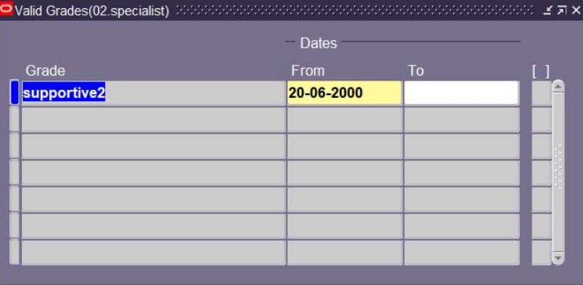
HR Senior Specialist

Slide 23
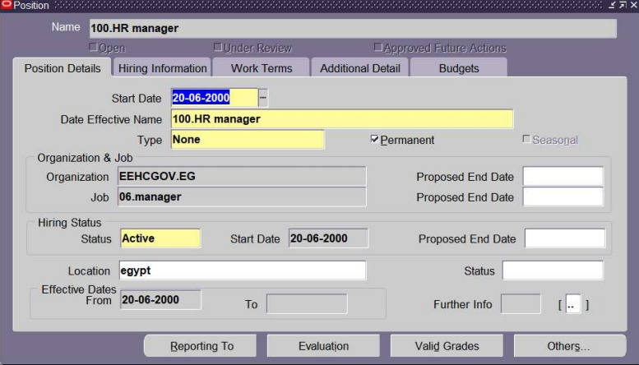
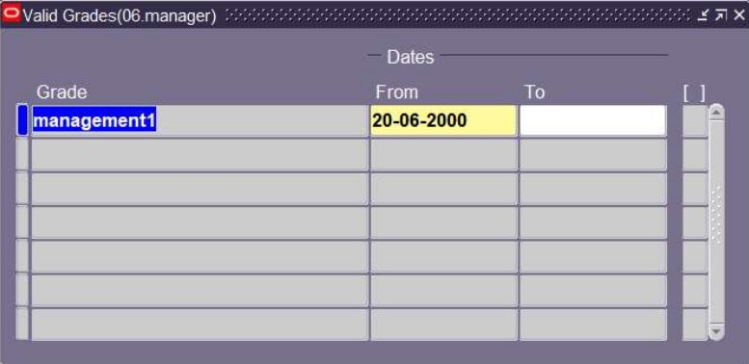
HR Manager

Slide 24
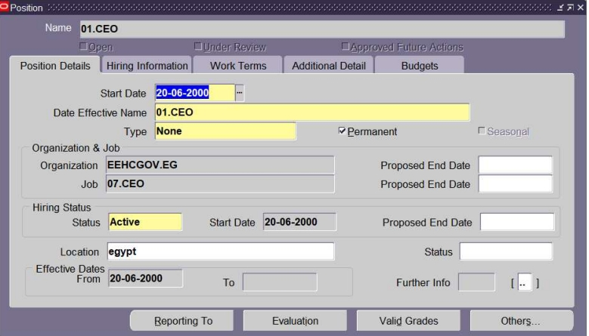
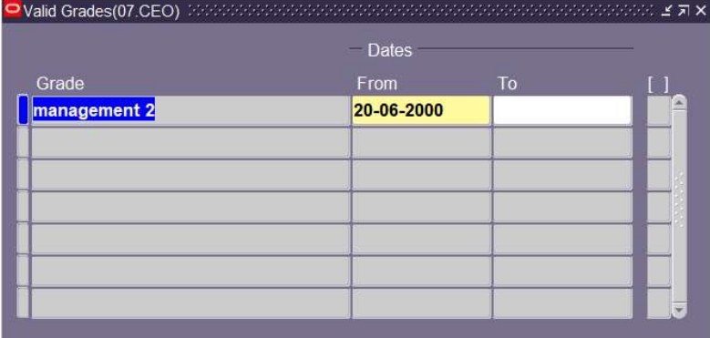
CEO

Slide 25
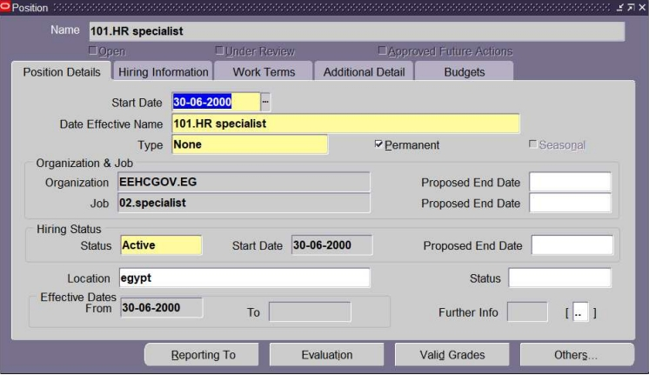
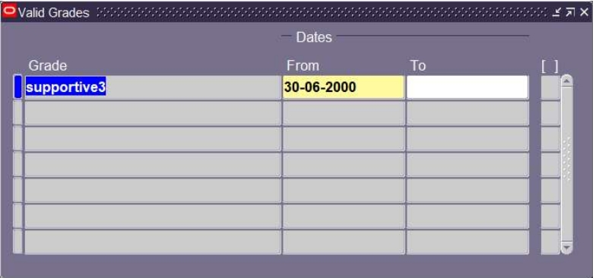
HR Specialist

Slide 26
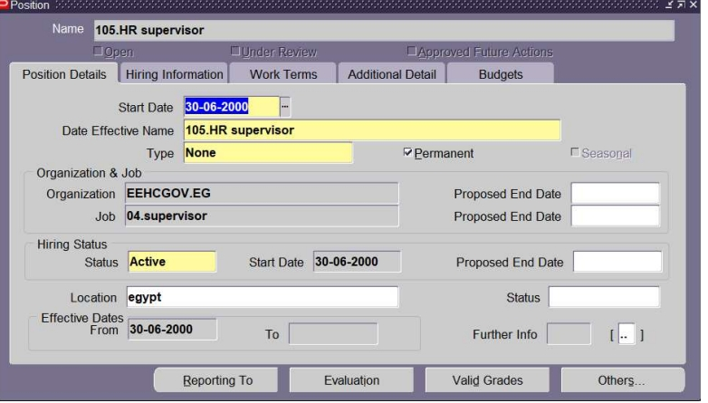
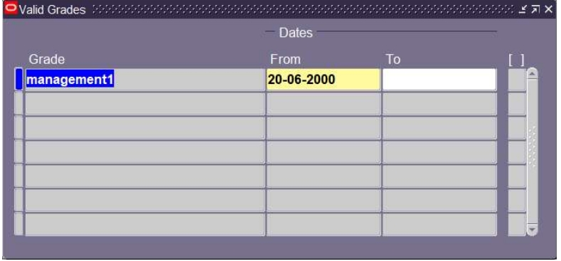
HR Supervisor

Slide 27

Accounting Employees at EEHC

Slide 28
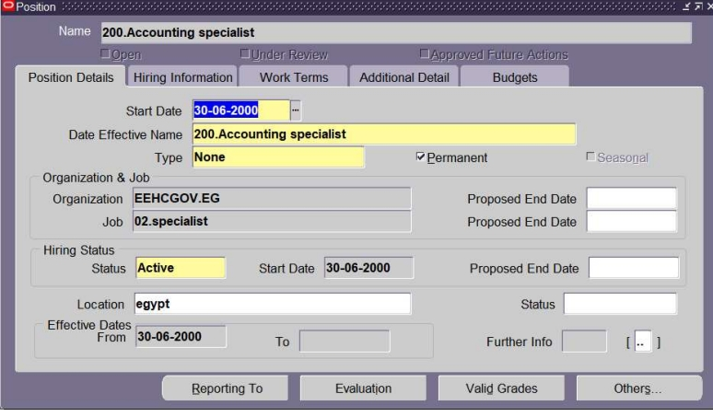
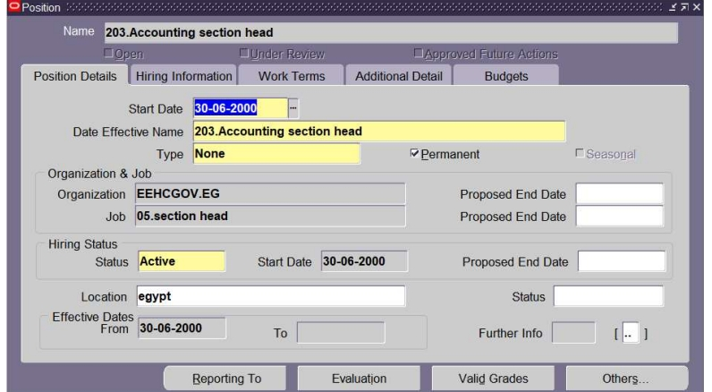
Accounting Specialist / Section Head

Slide 29
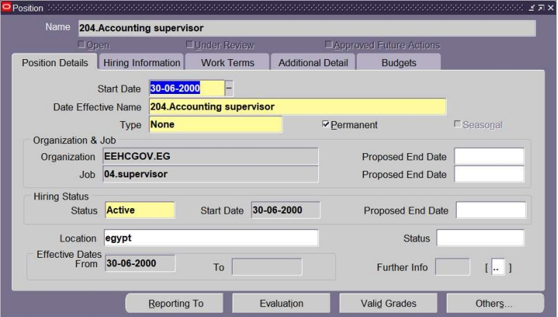
Accounting Supervisor

Slide 30
Research and Development Employees at EEHC

Slide 31
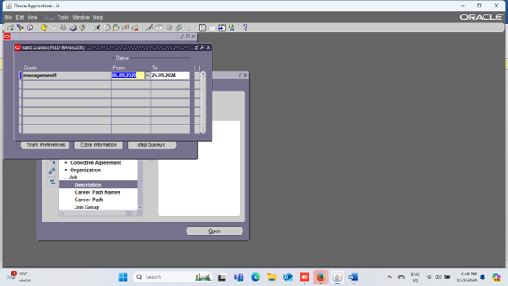
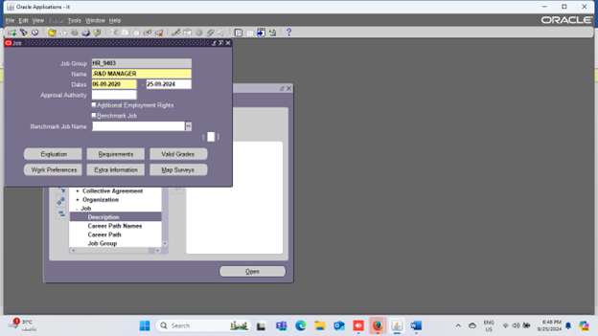
Research and Development Manager

Slide 32
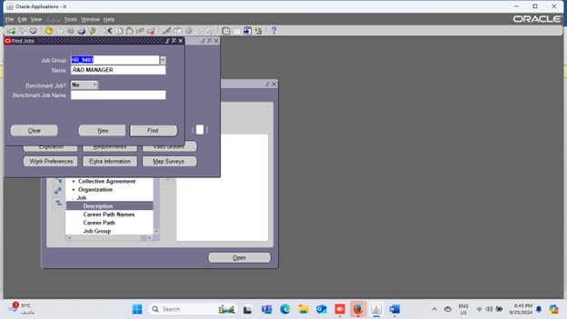
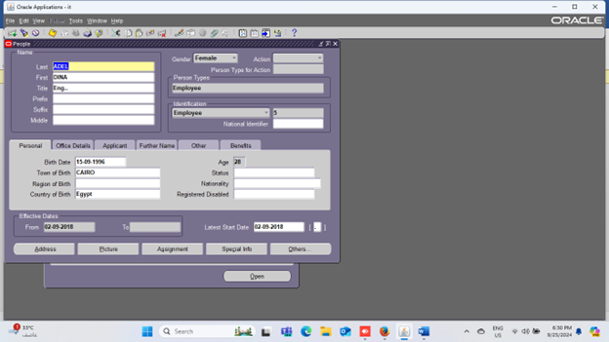
Research and Development Manager 2

Slide 33
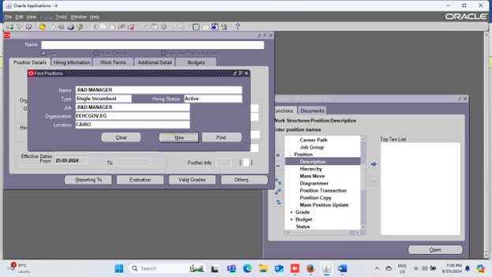
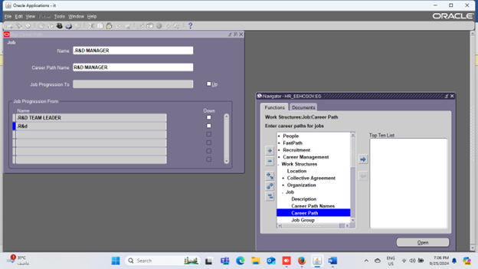
Research and Development Manager 3

Slide 34


Research and Development Leader

Slide 35
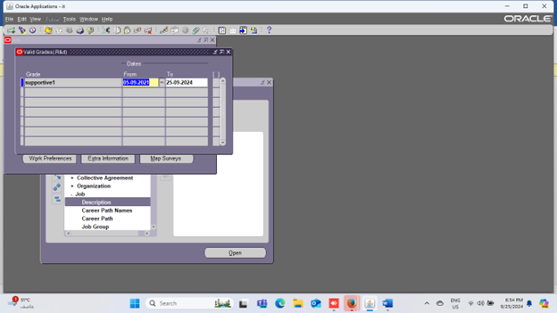

Research and Development Specialist

Slide 36
Customer Services Employees at EEHC

Slide 37
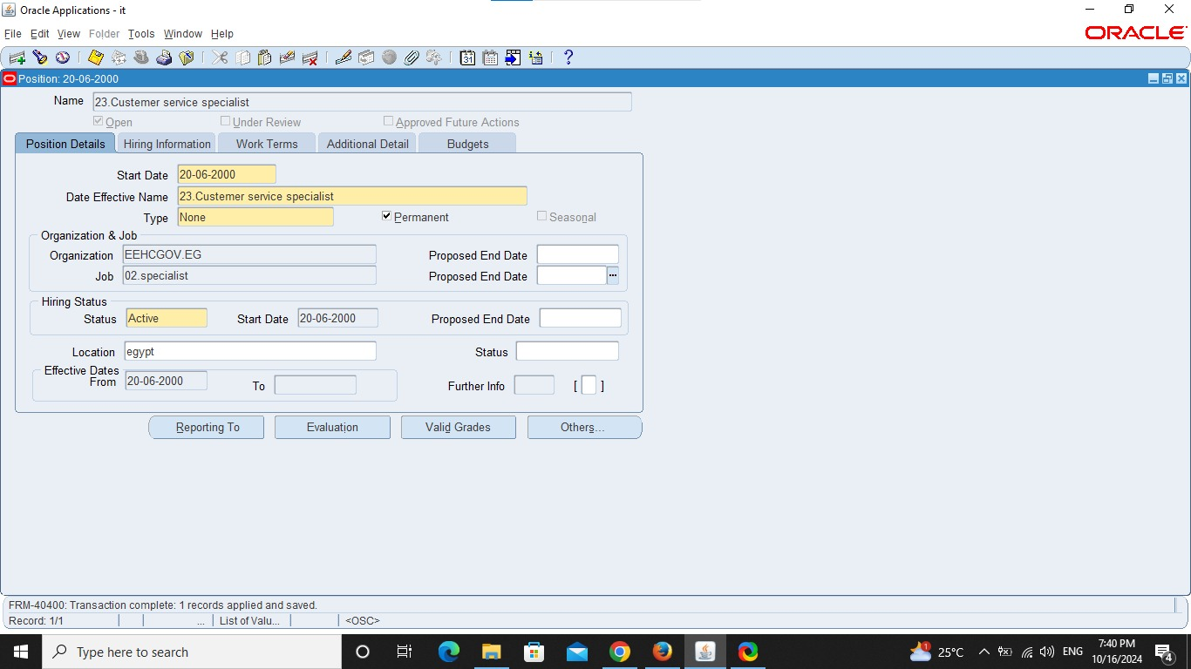
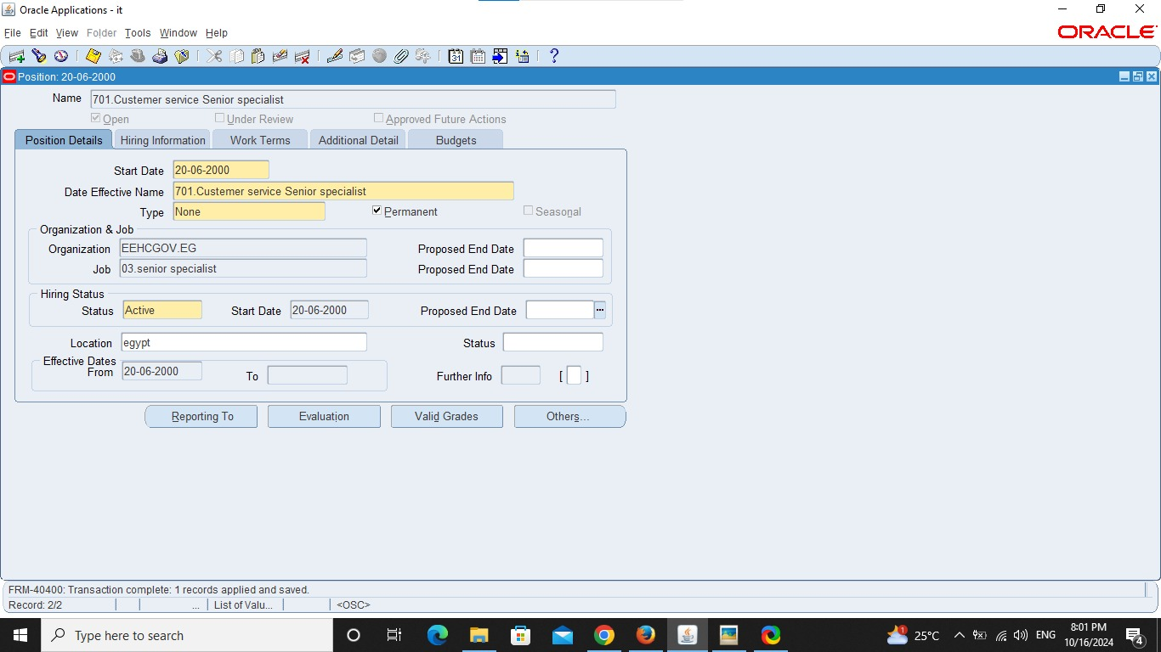
Customer Services Specialist

Slide 38
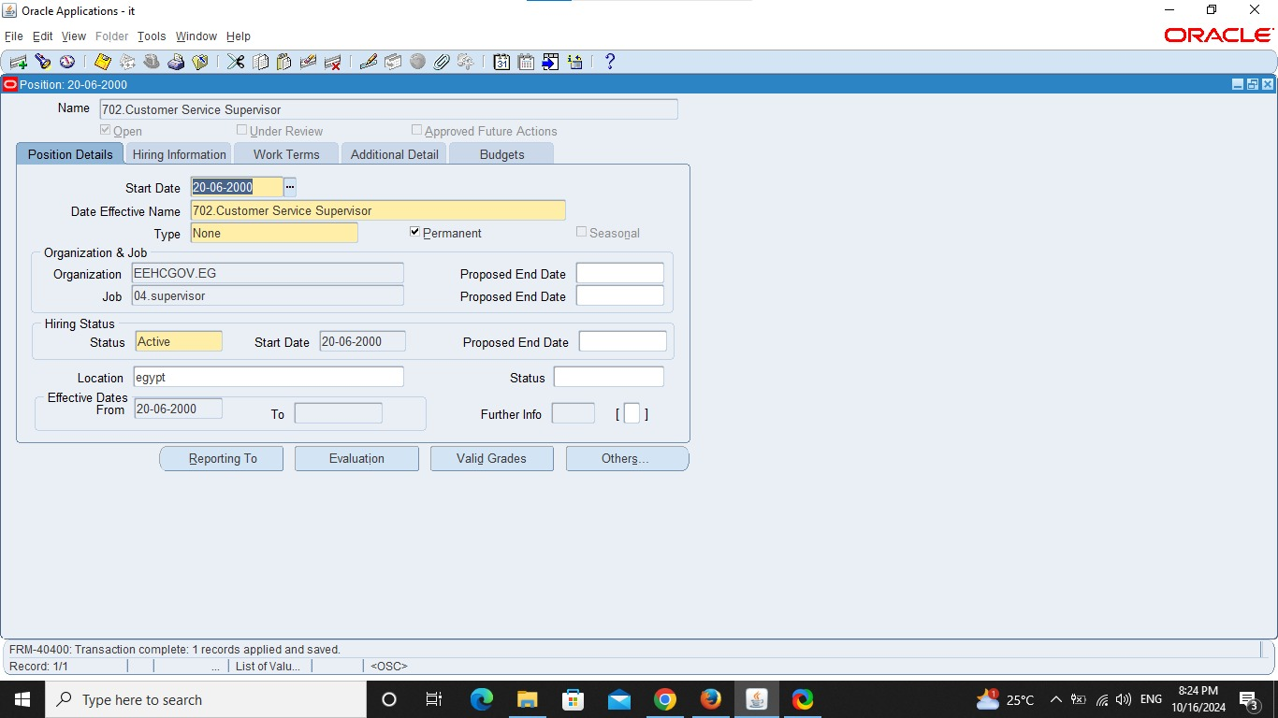
Customer Service Supervisor

Slide 39

Customer Service Manager

Slide 40
IT Employees at EEHC

Slide 41
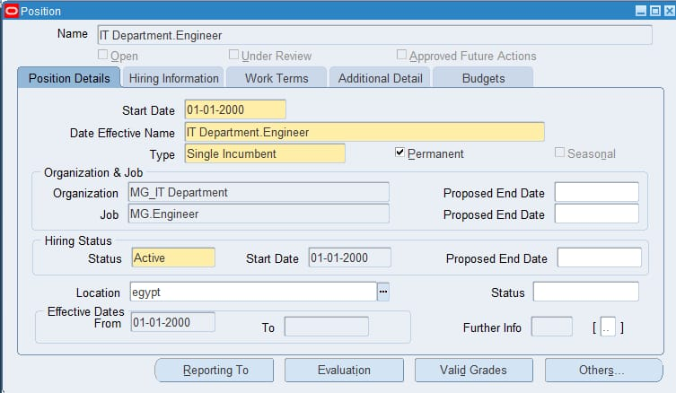
IT

Slide 42
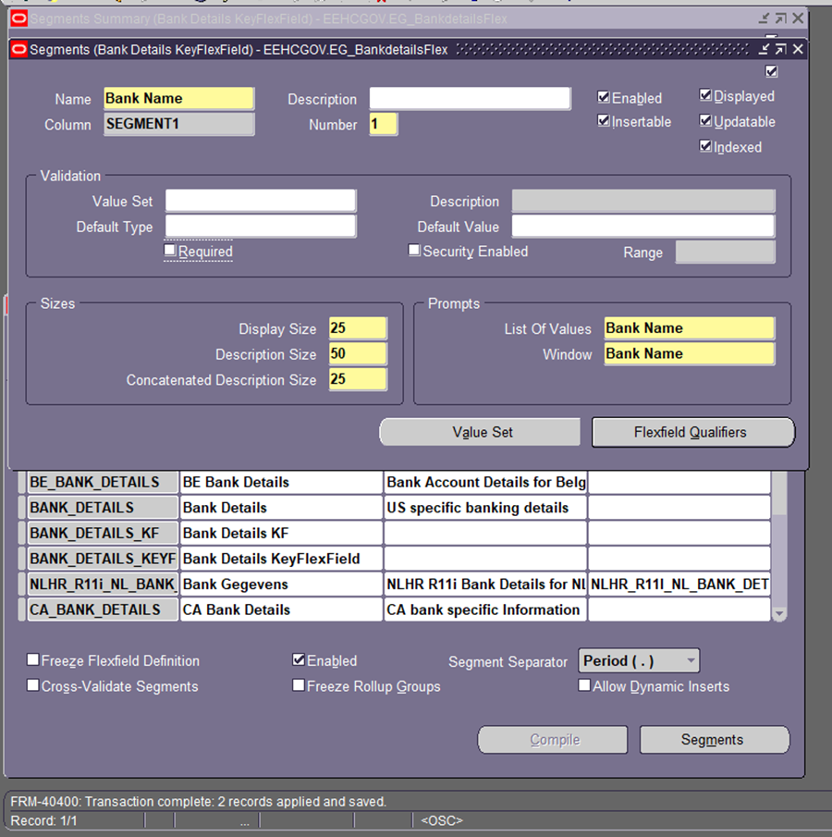
Add Bank Details
Log In: Open Oracle EBS and sign in.
Go to Setup: Click on Setup > Financials > Flexfields > Key.
Select Bank Accounts: Find and choose Bank Accounts.
Add Segments:
Add:
Bank Name
Account Number
Routing Number
Account Type
Set Basic Info:
For each segment, just name it and decide if it’s required.
Save Changes: Click Save to keep your changes.
Test It: Enter some bank details to check if it works.

Slide 43
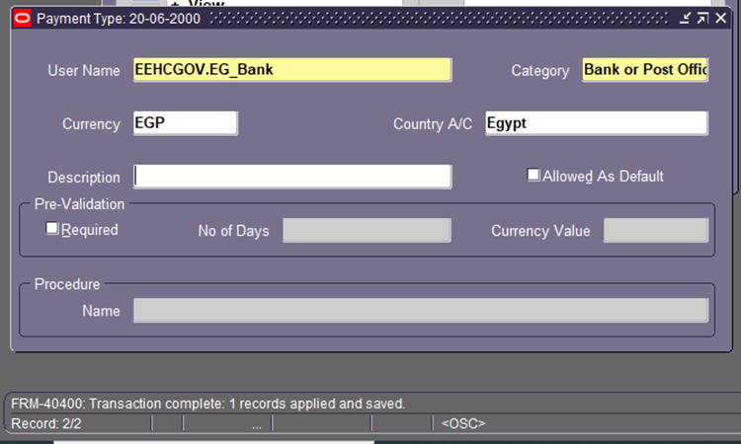
Payment Type
Log In: Sign in to Oracle EBS.
Go to Payment Types:
Click Setup > Payments > Payment Types.
Add New: Click New.
Name It: Enter a name (e.g., "Electronic Transfer").
Select Method: Choose the payment method.
Save: Click Save.

Slide 44
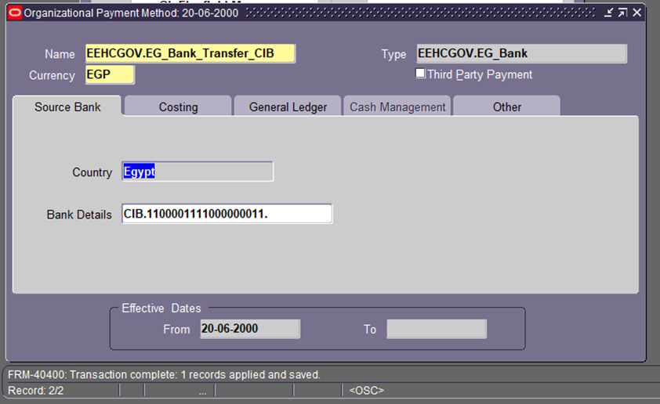
Payment Method
Log In: Sign in to Oracle EBS.
Go to Payment Methods:
Click Setup > Payments > Payment Methods.
Click New: Hit the New button.
Name It: Enter the payment method name (e.g., "Credit Card").
Save: Click Save.

Slide 45
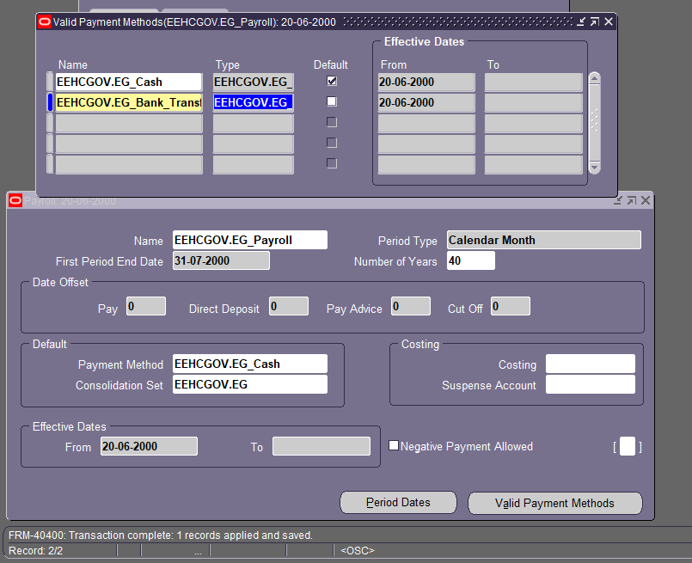
HR Responsibility – Payroll – Description

Slide 46
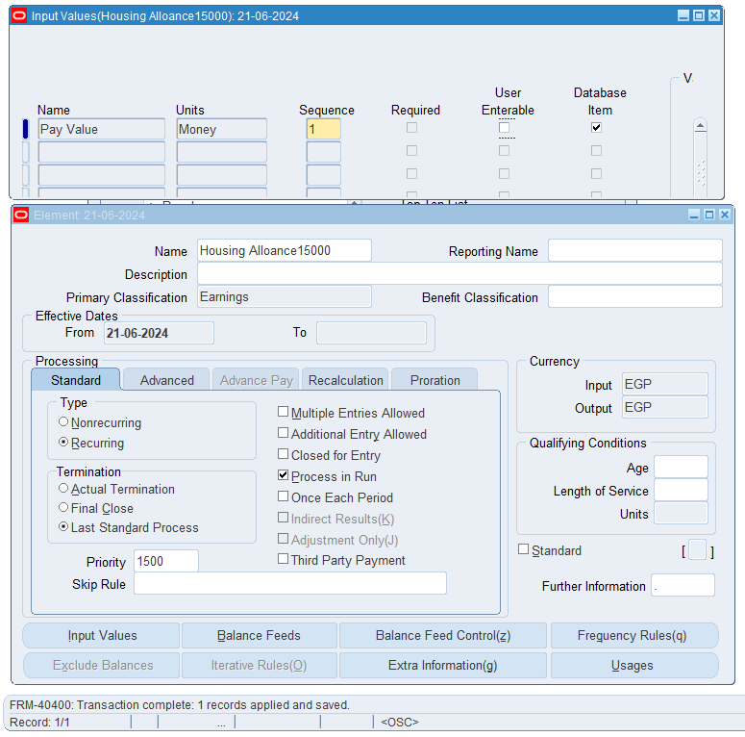

Slide 47
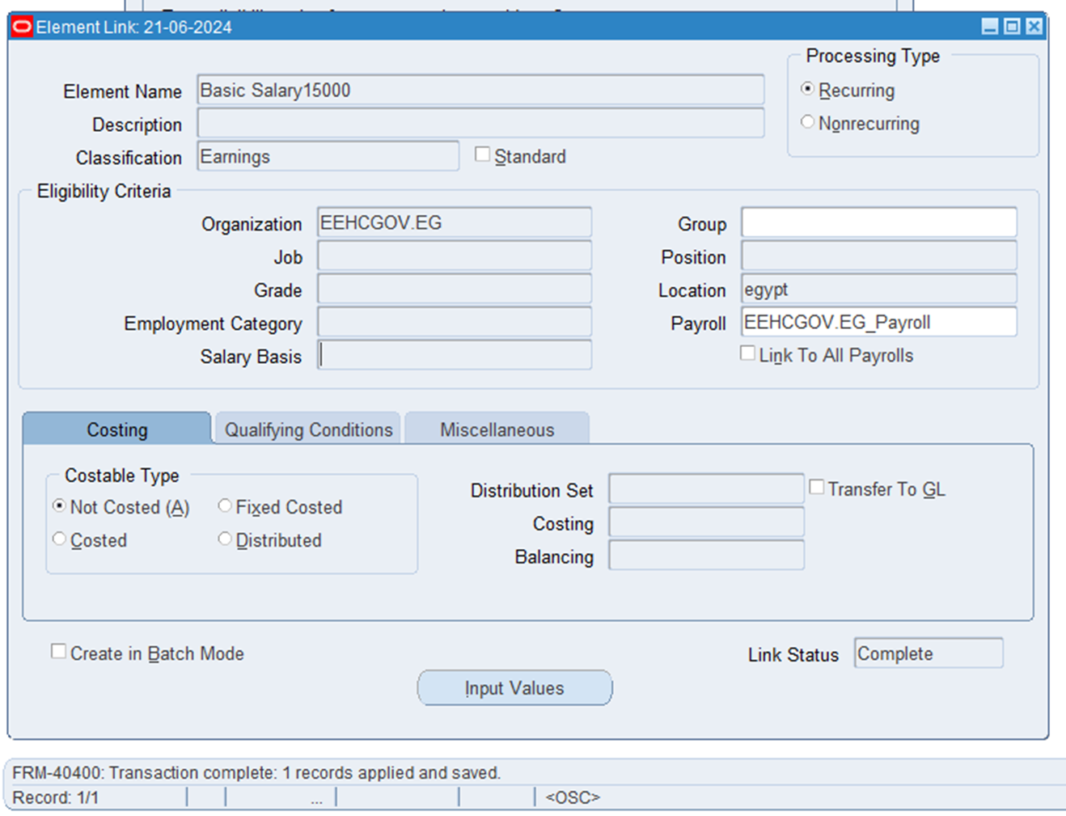
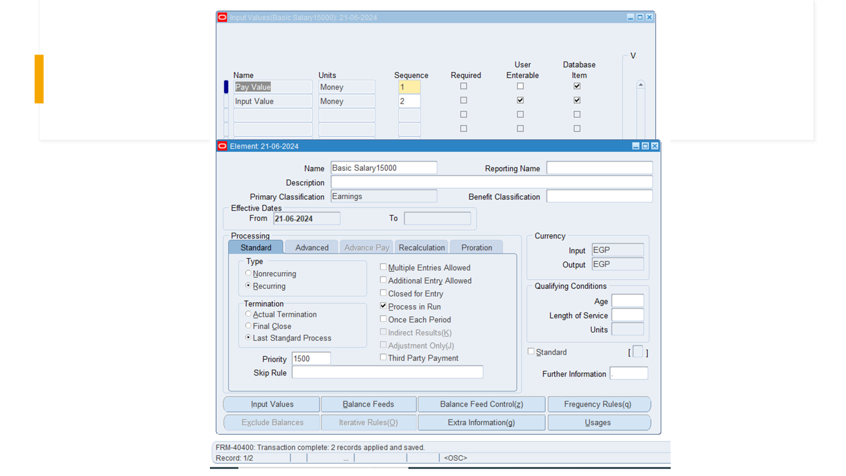
Basic Salary / Payroll

Slide 48
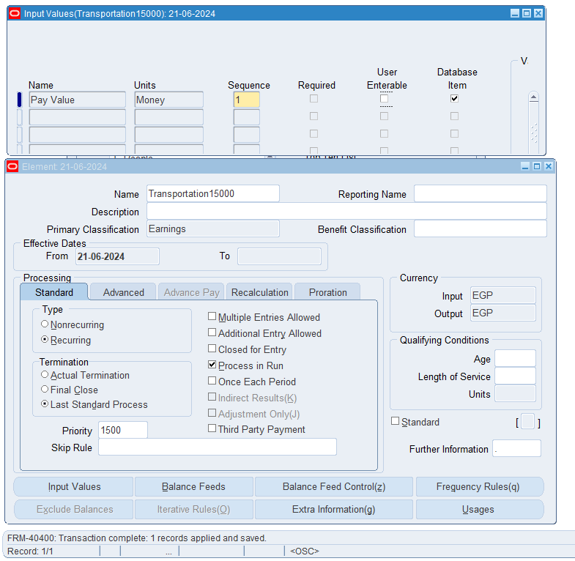

Slide 49


Slide 50

HR_EEHCGOV.EG
(HR Responsibility) – Total Compensation – Basic – Element – Description
HR_EEHCGOV.EG
(HR Responsibility) – Total Compensation – Basic – Element – Link Element To Payroll

Slide 51

Payroll Formula
Log In: Sign into Oracle EBS.
Find Formulas:
Go to Setup > Payroll > Formulas.
Create New: Click New.
Name It: Enter a name for your formula.
Type Formula: Write your calculation (like :Basic_Pay * 0.10).
Test: Click Test.
Save: Click Save.

Slide 52



Slide 53

Housing Allowance
Log In: Sign into Oracle EBS.
Go to Elements:
Click Setup > Payroll > Elements.
Create New:
Click New.
Enter Name: Type "Housing Allowance."
Select Type: Choose "Earnings."
Save: Click Save.
Assign to Employees: Go to employee records to assign it.

Slide 54



Slide 55

Transportation / Earnings

Slide 56

Link The Element
Log In: Sign into Oracle EBS.
Go to Elements:
Click Setup > Payroll > Elements.
Select Your Element:
Find and click on your element (like "Housing Allowance").
Link to Payroll:
In the element details, go to the Payroll section.
Choose the payrolls to link it to.
Save: Click Save.

Slide 57



Slide 58


HR_EEHCGOV.EG (HR Responsibility) – People –Enter & Maintain – Assignment – Entries
HR_EEHCGOV.EG (HR Responsibility) – People –Enter & Maintain – Assignment – Others – Quick Pay

Slide 59


Run the Payroll

Slide 60

Run The Request
Log In: Sign into Oracle EBS.
Go to Payroll:
Click Payroll > Processes > Run Payroll.
Select Payroll: Pick the payroll you want (like Monthly).
Set Dates: Choose the period for payroll.
Submit: Click Submit to start.
Check Status: Go to View Requests to see if it’s done.
Review: Look at the results when finished.

Slide 61

Thanks I appreciate your interest.

